Slide 1

GO2cam
Modules & Options

Slide 2
GO2cam
Modules & Options
I – Modules
II – Included Features
III – Options
IV – Products Description
V – Options Description
VI – Other Stand-Alone Solutions

Slide 3
I – Modules

Slide 4
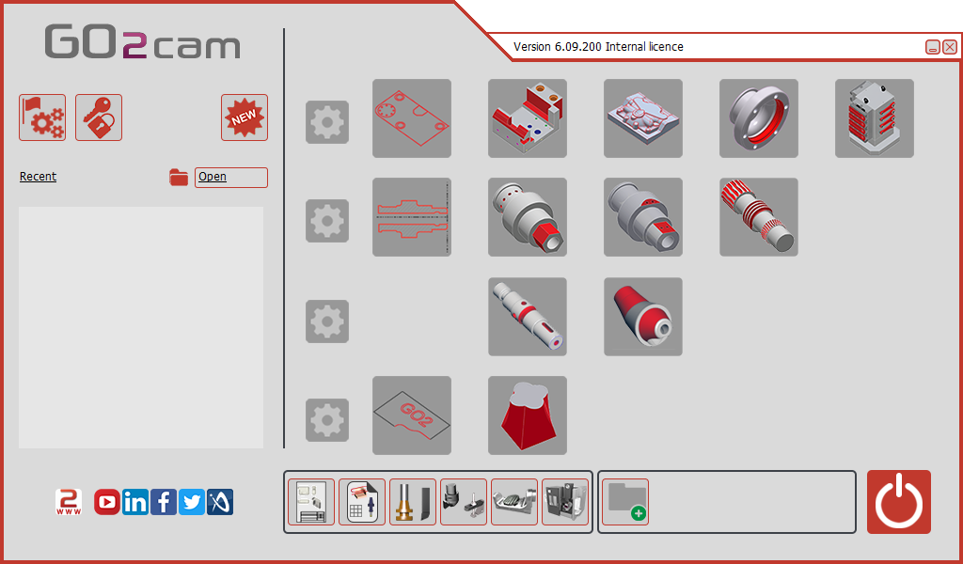








I – Modules
Mill Basic/
Mill Basic Plus
Mill Classic
Mill Expert
Milling
Turn Basic
TurnMill C Axis
TurnMill Classic
TurnMill Expert
Turning
Swiss Machining Expert /
Swiss Machining Full
Swiss Machining
Swiss Machining Classic
EDM Basic
EDM Classic
Wire EDM

Slide 5
II – Included Features

Slide 6



II – Common Features
Working Environments
Layout Design / Dimensioning
Dimensioning, titles blocks creation, standard workshop document, hatching, layout of solids…
Forming Tools / Tools Library
Creation of toolholders and tools from 2D design
Creation of forming tools
Definition of tools families…
Clamping / Toolholders
Creation of symbols: clamping elements, toolholders

Slide 7


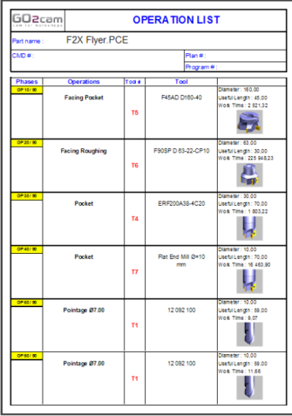
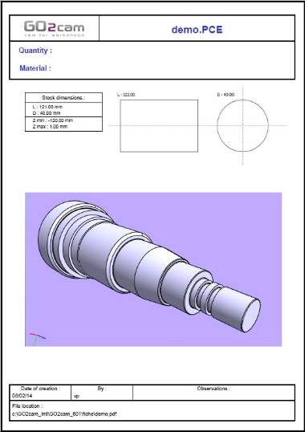
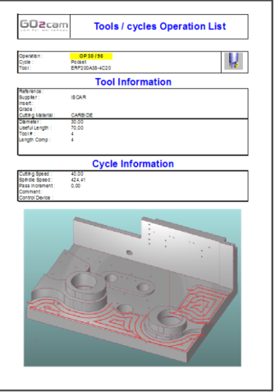
II – Included Features
Documentation
Workshop Documentation (needs MS Excel®)
3D PDF Workshop
Documentation

Slide 8
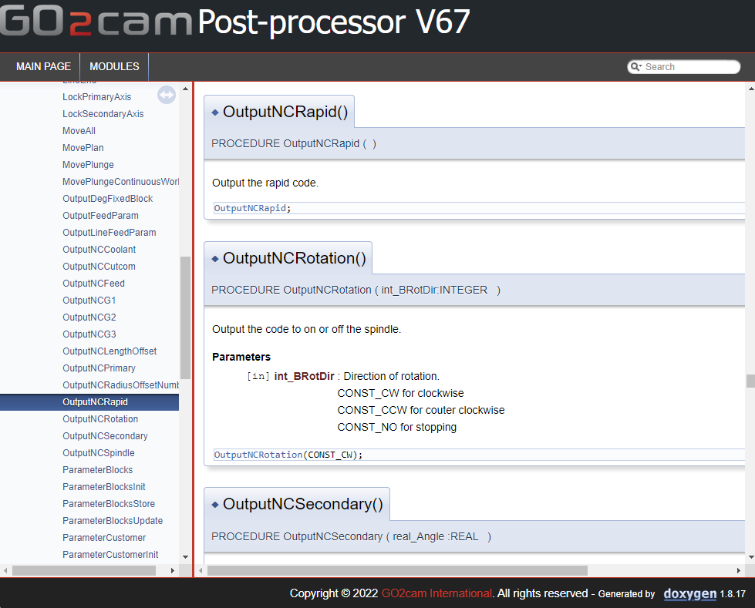
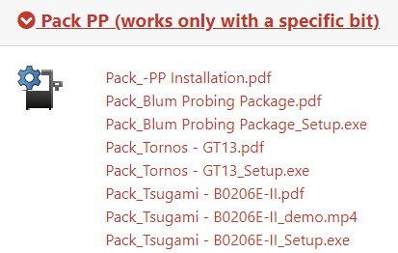
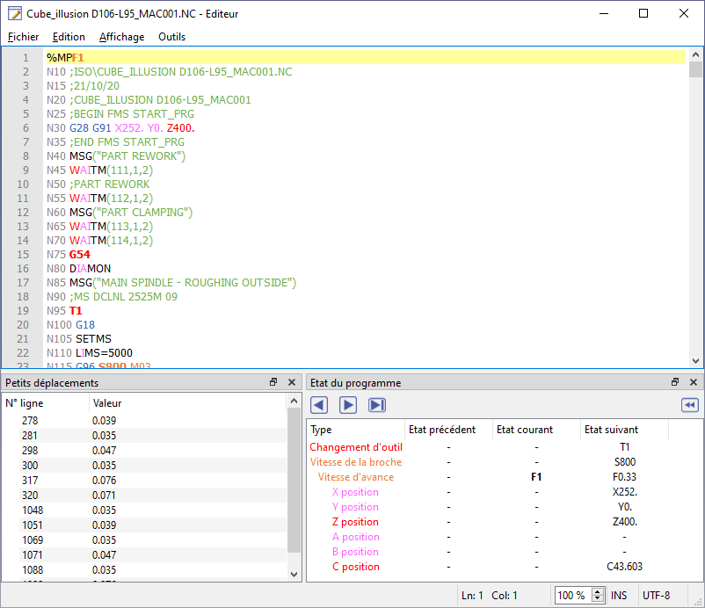
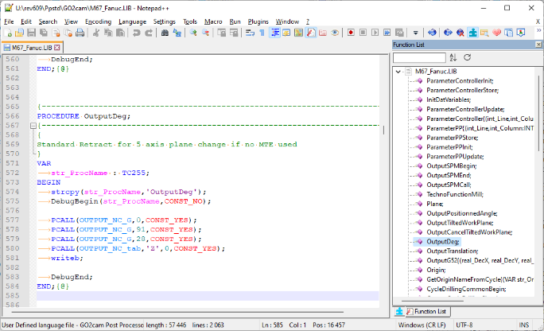
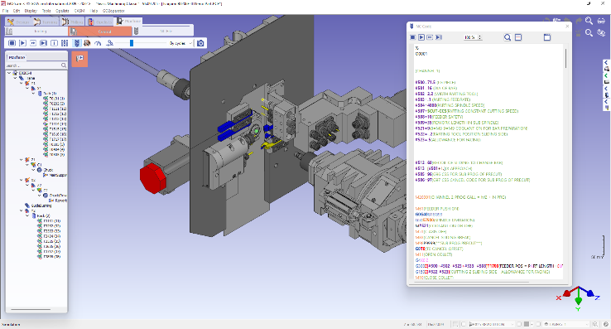
II – Included Features
Post-processor
Standard Post-Processors
Specific Post-Processors
Post-Processors Package
Turning : Fanuc, Siemens, Haas, …
Milling : Fanuc, Siemens, Heidenhain, Haas, …
EDM : Fanuc, AGIE, Brother, Mistubishi, …
Tools to customize PP (syntax colouring, function list, …)
Online help for standard functions
…
Full machine package
- Post-processor
- 3D simulation

Slide 9

IV – Description of Modules

Slide 10
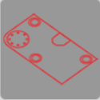
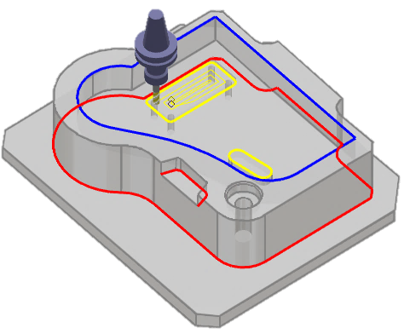
IV –Description of Modules
Mill Basic
Design
  Parametric Wireframe
Milling
  Pocket (including Pocket Reworking and HSM functions)
  Contour (and Contour Reworking)
  Holes Cycles
Possibility to import Solid CAD files,
Machining limited to 3 axes (no 4 and 5 axis positioning)
Mill Basic Plus
Same features as Mill Basic with on top:
Quick Solid Milling
Options
MTE
UWD
Probing

Slide 11
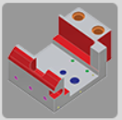
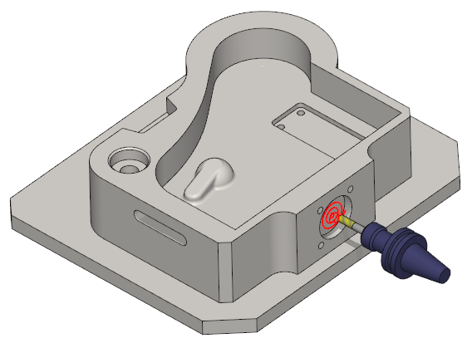
IV –Description of Modules
Mill Classic
Design
  Wireframe, Solid and Workplane creation
  Tolerancing module on 2D and solid (see Tolerancing Slide)
Milling
  Pocket (including Pocket Reworking and HSM functions)
  Quick Solid Milling (see Quick Solid Milling slide)
  Contour (and Contour Reworking)
  Shape (see Shape Machining slide)
  Holes Cycles
  Deep Drilling (see Deep Drilling slide)
  Milling in different workplanes: 5 axis positioning
Options
MTE
UWD
millyuGO© (incl. PAM)
Nesting
HMF
MPM
Boring Head
Probing

Slide 12
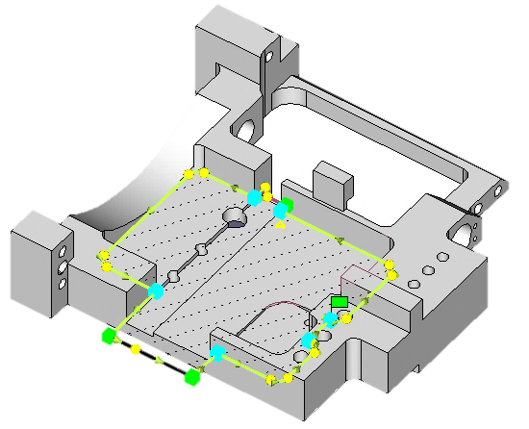
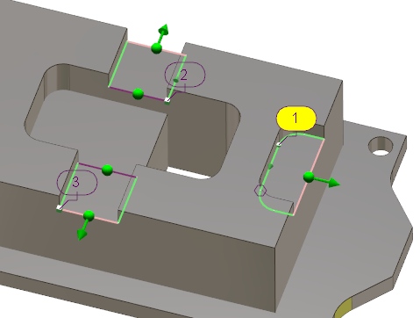
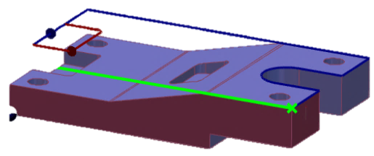
IV –Description of Modules
Mill Classic features
Quick Solid Milling (QSM)
Creation of profiles from the solid, which can be modified and manipulated without changing the solid
Several types of profiles to manage all shapes
Stock management
Automatic creation of workplanes
Management of undercut areas
Automatic recognition of fillets
Automatic open areas
Ability to machine ‘through material’ shapes
Also available with contour milling

Slide 13
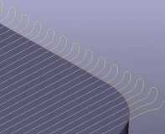
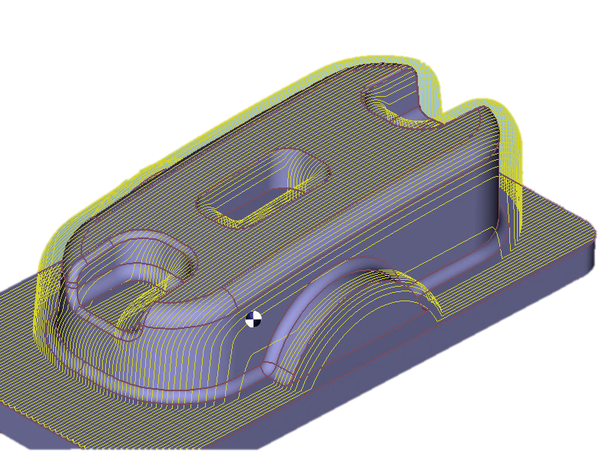
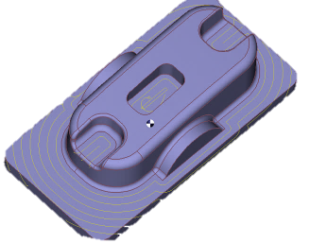
IV –Description of Modules
Mill Classic features
Shape Milling
3 axis machining for solids
Z level roughing
Z level rest material roughing
Raster machining (parallel plane)
Waterline (constant Z)
Isoparametric
Flat area machining

Slide 14
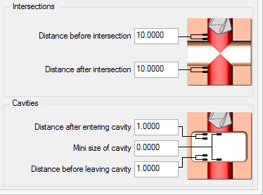
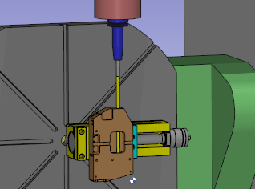
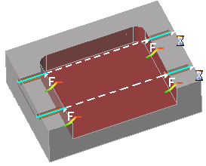
IV –Description of Modules
Mill Classic features
Deep Drill and Clevis
1. Drilling deep holes with management of feed and spindle speed at the start and end of machining and at intersections with other holes.
Crossing cavities can also be done with an acceleration.
Stop, coolant and delay can be defined along the toolpath.
2. Clevis mode enables definition of acceleration between 2 axial holes.

Slide 15

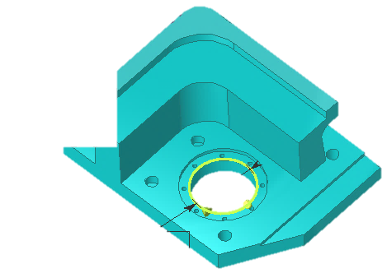

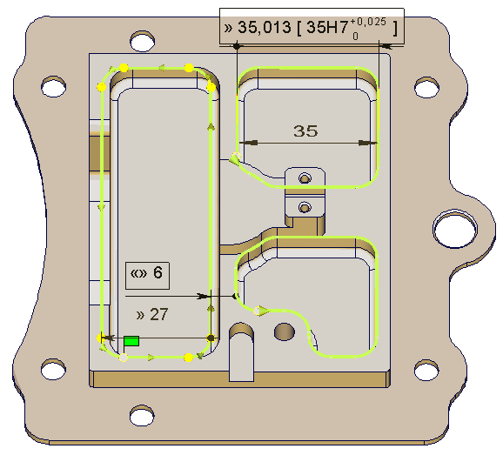
IV –Description of Modules
Mill Classic features
Tolerancing
Module available on 2D and 3D geometry, tolerances are defined on profiles.
Definition of linear, circular and angular tolerances.
It enables:
Creation of standard tolerances, with choice of type of dimension (average, extrema, nominal) and machining of the selected dimension
Modification or correction of a part topology without modifying the original model. Example: move of a hole, modification of a pocket width…
Easy recovery and use of tolerances defined on a CAD part

Slide 16
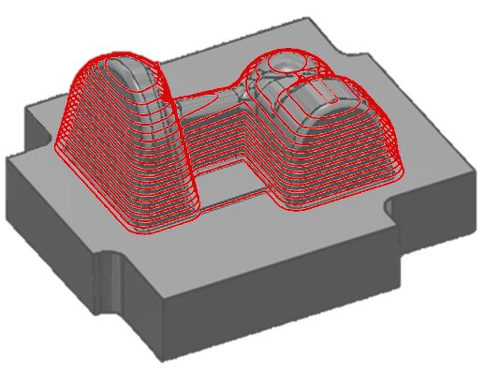
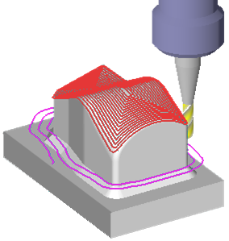
IV –Description of Modules
Mill Expert
Mill Classic + 3D Milling:
  Roughing (cubic initial stock or cast shape stock)
  Re-roughing
  Parallel plane (raster)
  Z Level (waterline)
  Spiral machining
  Pocket projection
  Equidistant (constant 3D stepover )
  Bi-tangency contouring (pencil)
  Machining of vertical and horizontal areas
  Rest areas machining
  Management of toolholder shape in all the toolpaths
Options
Same options as “Classic” +
4-5 Axis
5 Axis Expert
5 Axis Port
Multi-blade Classic
Multi-blade Expert

Slide 17

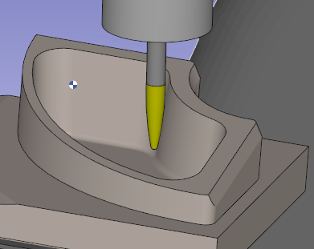
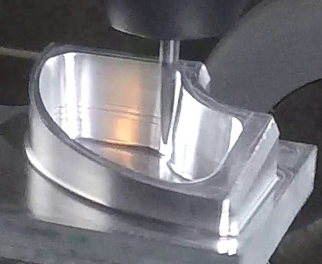
IV –Description of Modules
Mill Expert features
Barrel and lens tools management
In 5X Expert (also in 3 axis Z level), 3 new types of tools are managed: Oval Mill Cutter, Barrel Mill Cutter, Lens Mill Cutter.
Those new types of finishing tools enable a larger cut (Ap & Ae), thus much less steps than ball cutter, and a considerably better surface finish.

Slide 18
Turning
Available OPTIONS
TurnMill C Axis
MTE
MTE
MTE
UWD
UWD
UWD
TurnMill Expert
ALL Products
Turn Basic
HMF
millyuGO© (incl. PAM) *
SDK
HMF
All CAD Interfaces
Probing *
TurnMill Classic
Vericut
MTE
4-5 Axis
UWD
5 Axis Expert
millyuGO© (incl. PAM) *
5 Axis Port
HMF
Multi-blade Classic
Probing *
Multi-blade Expert
* with TurnMill machines

Slide 19
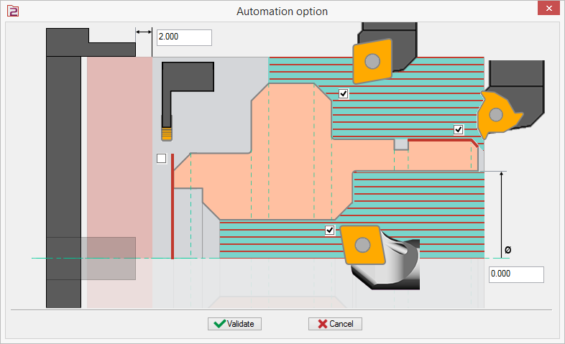
IV –Description of Modules
Common features to Turn / TurnMill
Automatic Opelists for turning
Can be applied on:
a solid
a 2D shaft (must be closed)
a DXF shaft (with 1 click of selection)
Automatic input of opelists: 2 axis turning opelists are applied without any action!
For this, define an opelist in which you set the dialog to determine:
The end of toolpath for Straight roughing and Boring,
If there is a chamfer or not for the Threading and the Parting
Stock is managed for inside operations.
→ Facing and grooving are automatically done, no settings are necessary!
→ The position of chuck is managed also!

Slide 20
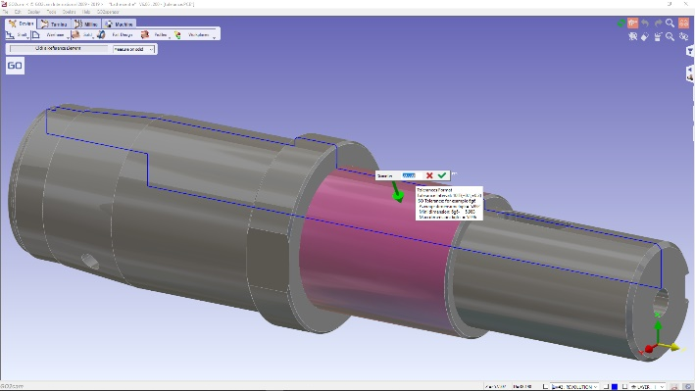
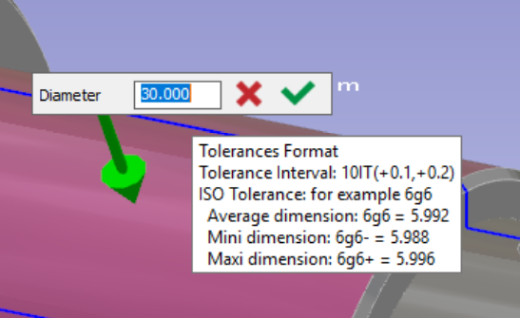
IV –Description of Modules
Common features to Turn / TurnMill
Tolerancing and solid editing
In turning, the Control function includes the possibility to modify dimensions of the solid, which offers 2 new powerful features to the user:
Add Tolerances
Define ISO tolerances on the solid: click a face and add a tolerance to the given value.
A hole defined with diameter 14H7 will be 14.009 mm, the average value; the same hole with 14H7+ will be 14.018 mm, the maxi value!
Modify the solid
The modifications are applied with smart topology recognition. Features:
- Chamfer and radius values kept if you modify a length,
- Modification of Keyseats,
- Multiple changes are supported (set of identical grooves for example)

Slide 21

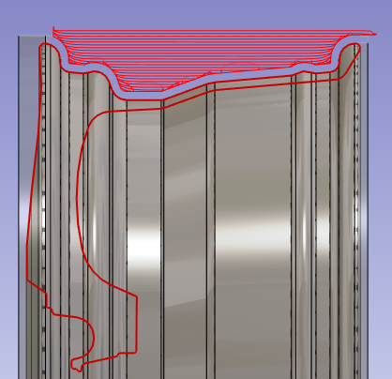
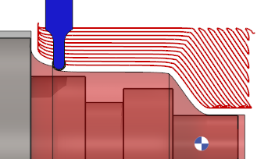
IV –Description of Modules
Common features to Turn / TurnMill
In TurnMill C Axis and upper modules
turnyuGO
As the similar milling operation ‘millyuGO’, turnyuGO is a roughing operation with a constant load of tool and regular chips. This operation can be programmed only with button tools.
Main benefits:
the tool is always in contact with material,
the tool is used uniformely and then protected,
the machining time is drastically reduced,
turnyuGO also includes G2/G3 to reduce the iso program. The program length is divided by 10.

Slide 22
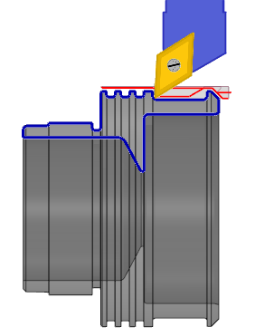
IV –Description of Modules
Turn Basic
Design
  Shaft creation, parametric wireframe design
Turning 2 axis
  Roughing and finishing
  Grooving
  Wtype grooving
  Z level grooving
  Threading
  Drilling
Possibility to import solid CAD files
Options
MTE
UWD

Slide 23
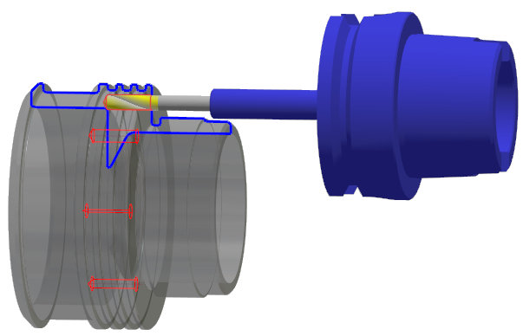
IV –Description of Modules
TurnMill C Axis
Design
  Shaft creation, wireframe, specific CAD for lathe and MillTurn technology, workplane creation
Turning
  Roughing and finishing
  turnyuGO (see turnyuGO slide)
  Grooving
  Threading
  Drilling
  C axis milling operations (standard PP to be adapted)
  Milling cycles for C axis
Options
MTE
UWD
HMF

Slide 24
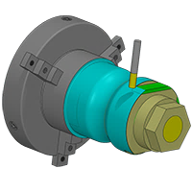
IV –Description of Modules
TurnMill Classic
Design
  Shaft creation, Wireframe, Specific CAD for lathe and MillTurn technology, workplane creation.
Turning
  Roughing and finishing
  turnyuGO (see turnyuGO slide)
  Grooving
  Threading
  Drilling
  C axis milling operations (standard PP to be adapted)
  Milling cycles for C axis and Mill Turn
  Dual spindle, dual turret, B axis and Y axis (only available with optional custom PP)
Options
MTE
UWD
millyuGO©
HMF

Slide 25
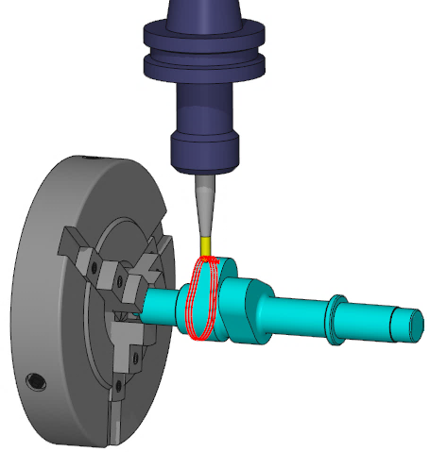
IV –Description of Modules
TurnMill Expert
TurnMill Classic + 3D Milling:
  Roughing (cubic initial stock or cast shape stock)
  Re-roughing
  Parallel plane (raster)
  Z level (waterline)
  Spiral machining
  Pocket projection
  Equidistant (constant 3D stepover )
  Pencil Milling (bi-tangency contouring)
  Machining of vertical and horizontal Areas
  Rest areas machining
Options
Same options as “Classic” +
4-5 Axis
5 Axis Expert
5 Axis Port
Multi-blade Classic
Multi-blade Expert

Slide 26

Swiss Machining
Available OPTIONS
Include
Include
Include
ALL Products
Swiss Machining Expert
Swiss Machining Full
Swiss Machining Classic
STEP reader
STEP reader
STEP reader
SDK
MTE
MTE
MTE
4 axis simultaneous
4 axis simultaneous
4 axis simultaneous
All CAD Interfaces
5 axis positioned
2 channels
5 axis simultaneous
2 channels
5 axis expert
3 channels
UWD
UWD
UWD
HMF
HMF
HMF

Slide 27
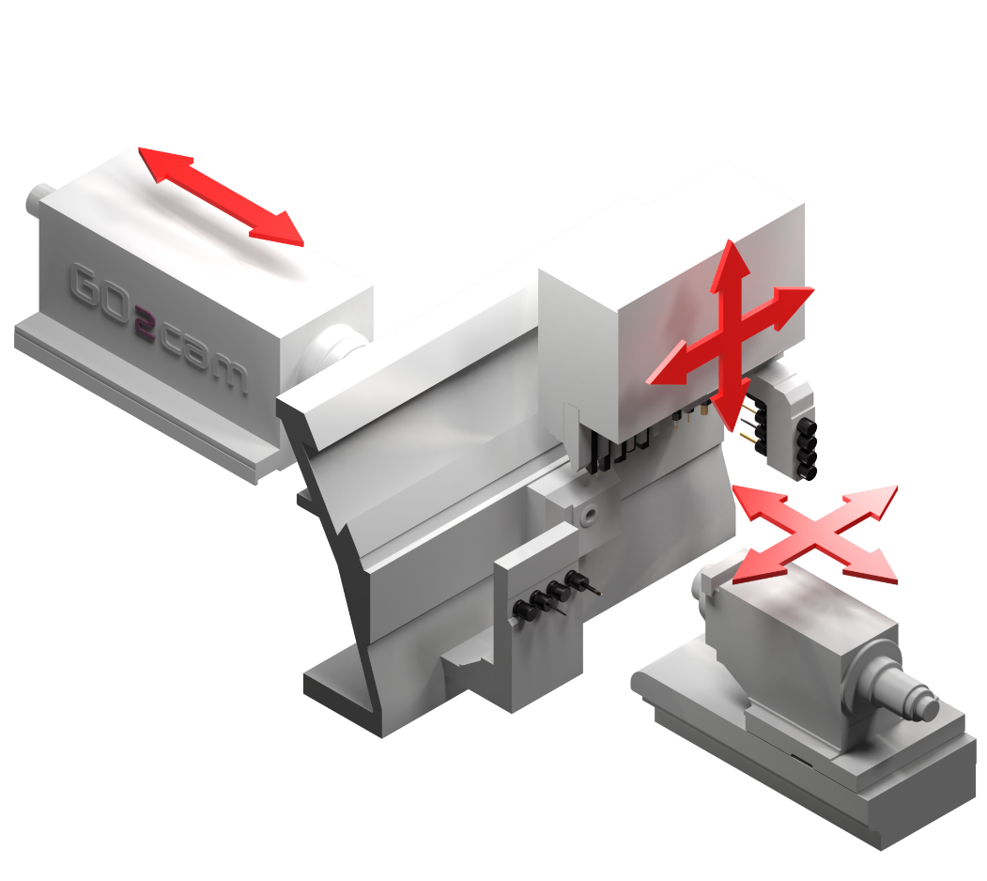
IV –Description of Modules
Swiss Machining Classic (SMC)
Design
  Shaft creation, wireframe and 3D parametric design
Machining operations
  Turning (facing, roughing, finishing, grooving, …)
  Swiss machining (Thread whirling, Die threading, form finishing, knurling)
  2D Milling (contouring, pocket, …)
  Shape Milling (roughing, finishing, Iso param…)
  4 axis milling (C axis in continuous with GO2cam cycles)
Swiss machining Features
  Machine tool environnement
  Swiss machining tool libraries
  Channel management
  Synchronization (on operation, on toolpath)
Machine range
2 channels
4 axis simultaneous
Options
UWD
HMF

Slide 28
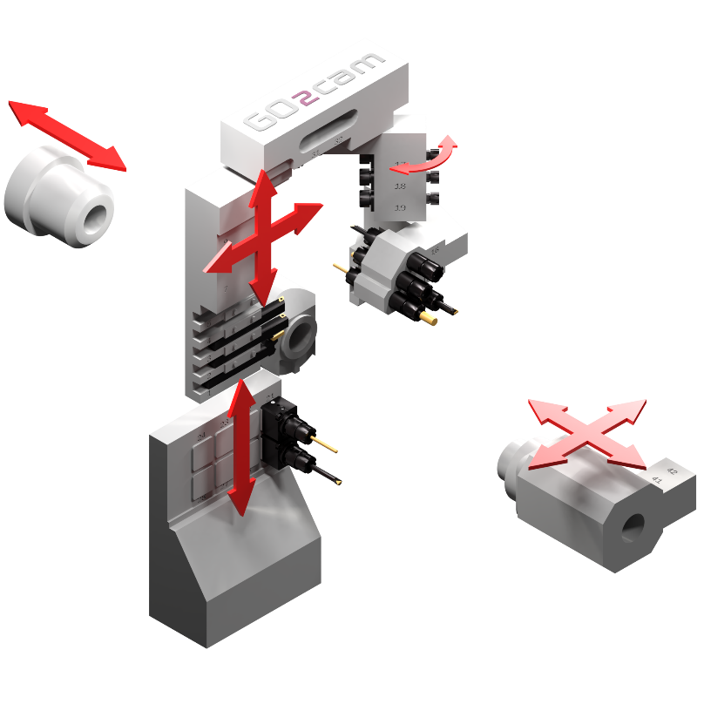
IV –Description of Modules
Swiss Machining Expert (SME)
Design
  Shaft creation, wireframe and 3D parametric design
Machining operations
  Turning (facing, roughing, finishing, grooving, …)
  Swiss machining (Thread whirling, Die threading, form finishing, knurling)
  2D Milling (contouring, pocket, …)
  Shape Milling (roughing, finishing, Iso param …)
  4 axis milling (C axis in continuous with GO2cam cycles)
  5 axis positioned
Swiss machining Features
  Machine tool environnement
  Swiss machining tool libraries
  Channel management
  Synchronization (on operation, on toolpath)
2 channels
Machine range
4 axis simultaneous
5 axis positioned
Options
UWD
HMF

Slide 29
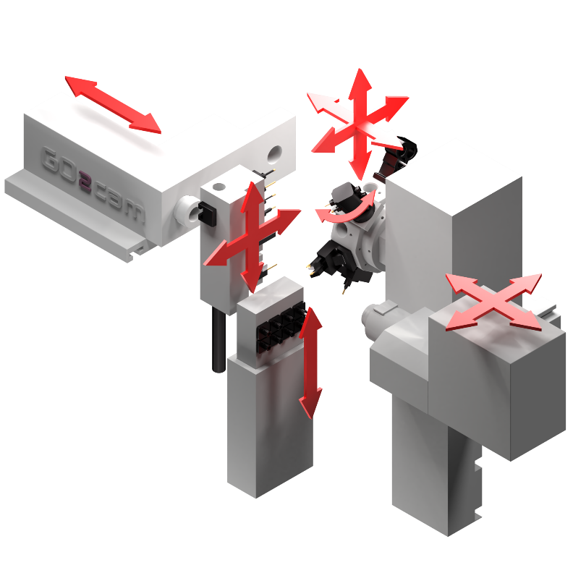
IV –Description of Modules
Swiss Machining Full (SMF)
Design
  Shaft creation, wireframe and 3D parametric design
Machining operations
  Turning (facing, roughing, finishing, grooving, …)
  Swiss machining (Thread whirling, Die threading, form finishing, knurling)
  2D Milling (contouring, pocket, …)
  Shape Milling (roughing, finishing, Iso Param…)
  3D Milling (Z Level, Spiral, Equidistant, Rest areas, …)
  4 axis milling (C axis in continuous with GO2cam cycles)
  5 axis simultaneous (GO2cam cycles + Mow Cycles)
Swiss machining Features
  Machine tool environnement
  Swiss machining tool libraries
  Channel management
  Synchronization (on operation, on toolpath)
Other features
  User Workshop Document
  Hole machining Features
3 channels
Machine range
5 axis simultaneous

Slide 30
Wire EDM
Available OPTIONS
EDM Basic
EDM Classic
UWD
UWD
ALL Modules
AgieCharmilles EDM Expert
Nesting
SDK
STTM
All CAD Interfaces
AgieCharmilles EDM Expert

Slide 31
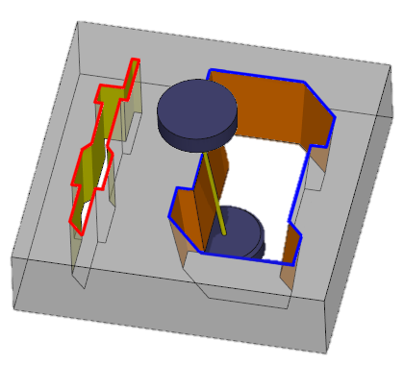
IV –Description of Modules
EDM Basic
Design
  Wireframe geometry
  Automatic threading point creation
  Multiple Slugs
EDM machining
  Cylinder Cut
  Taper cut with constant angle
  No core cutting
  Multiple pass cutting. Night/day strategies.
  Multiple areas machining with multi-slugs.
Options
UWD
AgieCharmilles EDM Expert

Slide 32
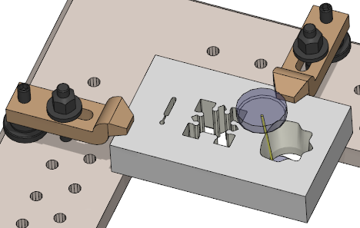
IV –Description of Modules
EDM Classic
Design
  Wireframe, solid, specific CAD for EDM
  Automatic threading point creation
  Multiple slugs
  Taper definition
  Creation of geometry according to tapers for 4 axis machining
  Dynamic setting of synchronization points
  New process on solids: click faces, topology recognition, automatic threading, synchro points…
EDM machining
  Cylinder cut
  Taper cut
  No core cutting
  Conic pocketing
  4 axis cutting
  Multiple pass cutting, Night/day strategies
  Inverted cutting, partial cutting, slug cutting…
  Multiple areas machining with multi-slugs
Options
UWD
Nesting
STTM
AgieCharmilles EDM Expert

Slide 33
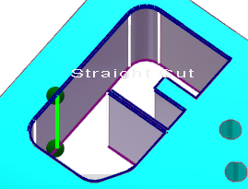
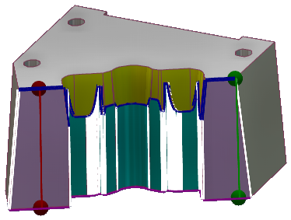
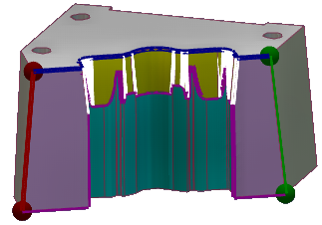
IV –Description of Modules
Wire EDM features
Quick Solid EDM
New functions to click the solid faces directly:
Topology and angles recognition (straight, taper, 4 axis)
Easy Start/End points creation
Threading holes are created automatically by recognition of the profile
4 axis shapes:
New double-profile for 4 axis machining
Synchro points are created automatically
Choice of different possibilities is given

Slide 34
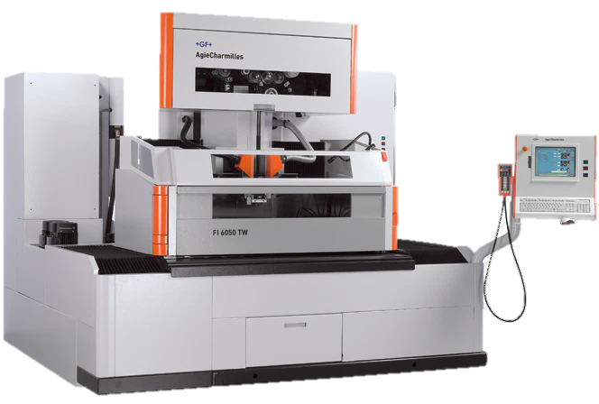
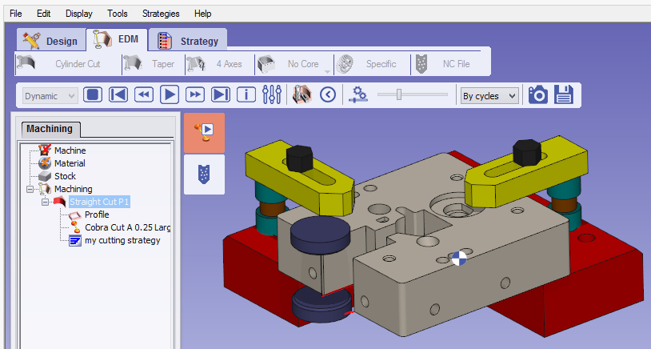
IV –Description of Modules
Wire EDM features
Standard post-processors for major machine-tool manufacturers: Fanuc, AgieCharmilles, Mitsubishi, Sodick, Makino, Hitachi…
Reading of technological tables for all the types of CNC and automatic calculation of the number of passes to apply to reach the desired quality.
Post-processors with specific command files:
Agie: generation of SBL and SBR files
Charmilles: generation of the CMD file
CT-Expert and Orange from AgieCharmilles
Automatic selection of strategies and cutting conditions of the machine
Link with GO2cam cutting conditions
Automatic creation of strategies with the appropriate number of passes and proper technologies (offset, setting…)

Slide 35
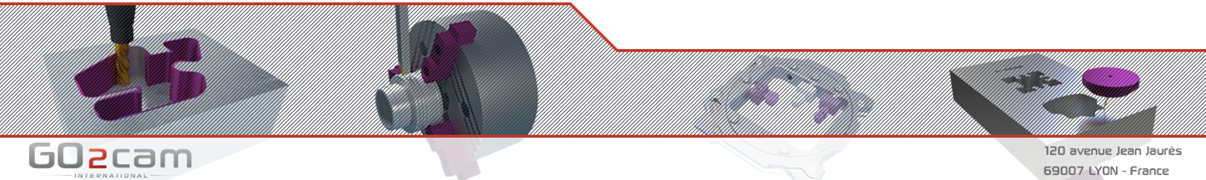
V – Options Descriptions

Slide 36
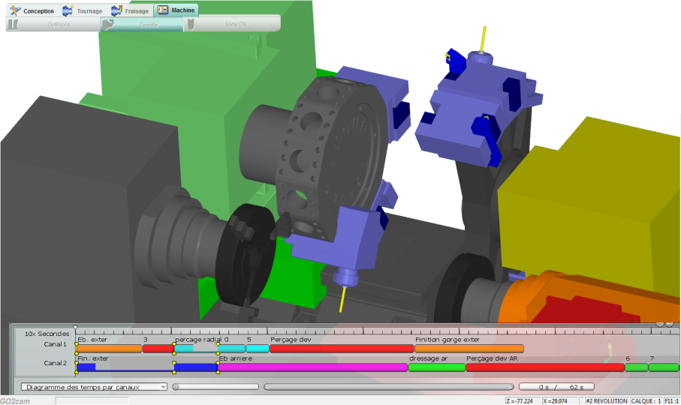
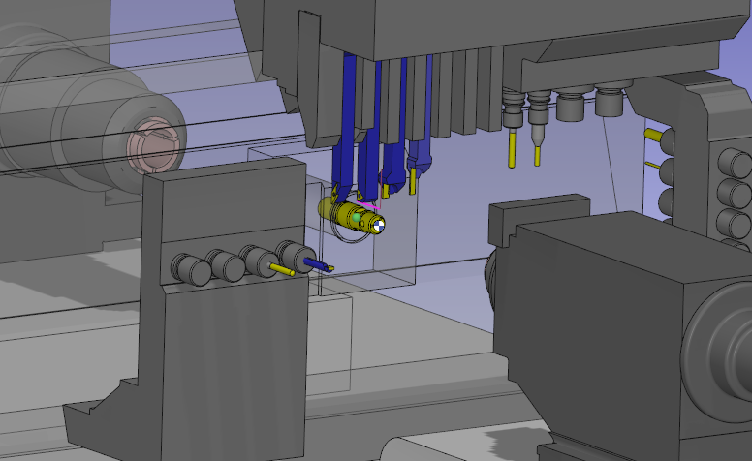

V – Description of Options
MTE
Machine Tool Environment
The Machine Tool Environment (MTE) is a powerful option dedicated to:
Creation of a machine kinematics from the CAD Model
Implementation of a machine kinematics in GO2cam in order to:
  Prepare tools needed for the machining of a part (mounting, numbering, setting of tools) in a realistic environment
  Control machining of the part within the complete machine environment
2 possibilities:
MTE Classic:
For Basic & Classic products
MTE Expert:
For Expert products
SwissTurn
Swiss-type lathes

Slide 37



V – Description of Options
NC control
Real NC code simulation using our MTE engine.
powered by
NC Control employs an integrated 3rd party verification algorithm to simulate real NC code. It’s cost effective, more accurate, rapid and flexibleHere are some advantagaes:
NC code simulation :
  NC code verification
  Controller cycles simulation
  Multichannel management
  Sub program simulation
  Available for most of NC controllers
Integration in GO2cam MTE :
  Full 3D machine simulation
  Collision control
  Material removal simulation
  Axes limits warnings
  No export / import from datas (stock, finish part, clamping system, tooling,…)
  Only one machine model in CAM and NC simulation
  All in one environnment

Slide 38




V – Description of Options
NC control
Real NC code simulation using GO2cam MTE engine.
powered by

Slide 39



V – Description of Options
millyuGO©
Constant Tool Engagement for roughing and pre-finishing *
Three patents into a comprehensive millyuGO option. It encompasses:
High efficiency cycles for roughing
High efficiency cycles for finishing preparation (leaving adaptive allowance) *
Thin wall avoidance toolpath calculation
These cycles ensure constant tool engagement throughout the cycles. As a result:
  Forces exerted on tool and spindle are controlled
  Tool always cuts within its optimal and designed conditions
  Ideal for hard material: Titanium, Inconel, stainless steel
  Less machine vibration
Benefits
  Tool life: up to x6 longer
  Machining time: reduced by 80% in roughing
  Production costs: reduced by 50%
* formerly option

Slide 40




V – Description of Options
HMF
Hole Machining Features
Association of shapes and list of operations
Automatic Machining
Library of HMF templates
Possibility to create custom templates
Application of HMF on:
GO2cam 2D geometry
Imported 2D geometry
Hole recognition on solids
Probing
Three types of probing
Probing of stock to fix the alignment
Probing of stock for the origins
Probing of part to control dimensions
Features
Many predefined strategies
Automatic rapid moves calculation
Stock Management

Slide 41



V – Description of Options
Deburring
3 Axis Deburring
Powerful 3 Axis toolpath with:
Automatic selection (with advanced options for edges detection)
ability to exclude edges of a selection
Powerful gouge checking
Available for 3 types of tools.
Accessible in the menu Shape, in a dedicated submenu.

Slide 42




V – Description of Options
MPM
Multiple Parts Machining
  MPM aims at producing multiple parts, that can be single or different (no limitation in the number of parts)
  This option works on PCE files from GO2cam. Parts cannot be imported or designed.
  2 modules:
  3 axis: to produce multiple part on a table
  4-5 axis: Tombstone fixtures management / MTE machine (no limitation in the number of supports)
Features:
Stock Management
Rapid move management between parts and supports
Optimization according to tool change or tombstone rotation
Update of modifications: access to milling for any type of modification such as tool change, cutting conditions, strategy…

Slide 43


V – Description of Options
Boring Head
Boring Head (Andrea)
Machining in a milling center with a boring head, such as the ones from the most famous manufacturer d’Andrea.
Turning operations are included.
Available to any milling center: Vertical or Horizontal.
Limitation on machine:
1 only rotary axis IS MANAGED NOW!

Slide 44



V – Description of Options
UWD
User Workshop Documents
Creation of customized documents, that will be used in the Workshop documentation.
Features
Design the sheets with wireframe geometry
Add 3D windows to display: part, cycles, tools & Solid Layout
Add general and technical vocabularies easily from categorized lists
Create fixed vocabularies and user questions
Insert images
Design tables
We provide you a document manager:
Several documents can be defined in one file
You can set the format (A4, A3…), the orientation and margins of document.
Templates can be created and re-used for the next documents.

Slide 45


V – Description of Options
Nesting
Nesting (for wire EDM)
New interface with menu « Extra » with optimized Nesting
Optimized positioning of multiple punch shapes in a predefined stock.
Multiple possibilities of nesting:
1 shape x times or
n shapes 1 time or
n shapes x times
- The shapes which can not be nested are pointed out in the table
- Pre-visualization before calculation
Nesting
Nesting (for milling)
Opelists can be created for process optimization
Use of layers
Quick stock creation (all stock size are saved inside text file)
Creation of connectors

Slide 46




V – Description of Options
STTM
Swiss Turning Tool Manufacturing
Application for the design and manufacturing in EDM of Turning Tools for Swiss Turn.
Less than 10 minutes to design and program the shape to machine with 4 axis toolpath.

Slide 47



V – Description of Options
4-5 Axis
4-5 axis simultaneous milling
5X Swarf
4 Axis Simultaneous Cycles:
4X Finishing by facing or pocket toolpath
4X Profile Projection
4X Profile Marking
4X Parallel Plane Finishing
4X helix toolpath
5 Axis Simultaneous Cycles:
5X Swarf on single profile
5X Swarf on dual profiles
5X Equidistant
5X Pocket Morphing
5X Isoparametric
5X Drilling
5X Isoparametric
5X morphing with undercut management

Slide 48



V – Description of Options
5 Axis Swarf
Options of
4-5 Axis
5 Axis Swarf
New powerful and automatized 5X Swarf Toolpath
5 Axis Expert
5 Axis Expert
4 & 5 axis toolpaths library
- Predefined strategies for 5X Swarf, 5X Cavity, 5X Projection, 5X multi axis roughing,
- New 5X Deburring
- Powerful options for:
  Approach/link control
  Tool axis control
  Collision avoidance

Slide 49












V – Description of Options
5X Multiblade
5 axis multiblade
Option of
4-5 Axis
5 Axis Expert
Predefined operations:
  Roughing
  Hub Finishing
  Floor Finishing
  Blade Finishing
5X Multiblade Expert
5 axis multiblade expert
Roughing
Blade Finishing
Hub Finishing
Fillet Finishing
Advanced Module
Sorting, linking and smoothing options
Roughing options:
  Morph, hub offset, shroud offset
  Automatic collision control
  Feed control on 1st cut
Specific finishing operations
5X Port
5 axis Port
Tilting through point method,
Powerful links / approach options,
Control of collisions…

Slide 50


V – Description of Options
Vericut
Link with the application Vericut
Vericut is a software for analysis, verification and simulation of toolpaths.
The link with Vericut is an export of data. It is done through a standard Macro, accessible in menu Tools / Standard Macros / vericut.ppi
Link with Vericut is available for Milling and Turning.

Slide 51




V – Description of Options
SDK
Software Development Kit
SDK provides access to function to customize and drive GO2cam.
When specific application is developed, the end user license needs the SDK bitcode to use it.
Available programming languages :
- GO2cam macro language (Pascal based language)
- C, C++, C#, VB.net via COM technology
SDK can be used to :
- specific features creation
- automatize CAD creation
- automatize CAM processes
- black box creation (use of GO2cam hidden)
- …

Slide 52



V – Description of Options
DataGO
DataGO direct interfaces
Direct Interface with CAD systems, with recovery of holes information and associativity with CAD
Holes Features | Catia V5 | NX | Catia V6 | Creo
Recognition
Update (placement)
Update (type change) Tapped → Counter bored
Update (type update) M4 → M6
Update (add hole inside existing group) Catia V5: Need to delete existing toolpath and to create toolpath NX: Need to delete existing toolpath and to create toolpath
Update (add new hole)
Update (Delete Hole) NX: Need to delete all existing tool path
Pattern
Milling Faces | Catia V5 | NX | Catia V6 | Creo
Part Update (dimension) Part 1 → Part 2
Part Update topology Part 1 → Part 3
Turning part (Revolution section)
Testing
Under development Datakit
Testing
Under development Datakit
Available with Catia V5, Catia 3DEXPERIENCE (V6),
NX and Creo

Slide 53


V – Description of Options
AgieCharmilles
EDM Expert
Link with application EDM Expert from AgieCharmilles.
EDM-Expert application has several objectives:
Enable the CAD/CAM users to accede to the AgieCharmilles data and build « ready to use» machining strategies
Centralize the access to AgieCharmilles machines thanks to a unique interface
Provide an easy interface for CAD/CAM users
Principle: EDM-Expert interface will provide simple functions to define the machining requirements and the target machine options
The interface will deal with the several EDM-Experts according to the machine model and specific interfaces and provide the required data to the CAM/CAM
A post-processor has been created to manage this application: E60_AgieCharmilles_EDM_Expert.SPE

Slide 54
VI – Stand-Alone / Plug-in Solutions

Slide 55


GO2cam for SolidWorks
The CAM software integrated in SolidWorks, developed by GO2cam International.
Enjoy all the benefits of GO2cam inside the most famous CAD software!
Full integration,
Powerful 3D CAD functions,
Work possible only on 1 SW part, not assemblies.
*** IMPORTANT *** The user must be owner of an official SolidWorks license. Plug-in GO2cam for SolidWorks can only be started through SolidWorks interface.

Slide 56


GO2designer
The stand-alone software solution developed by GO2cam International
GO2designer is dedicated to preparation of files before CAM programming:
Import of CAD files
Creation of symbols
Design of geometry
Design of layout of the file for printing

Slide 58







GO2operator
GO2operator is a solution for an efficient communication between CAM programmer and CNC operator. Now available with touchscreen.
CAM programmer defines administration rights of the CNC operator. Modifications made by the operator (when saved) are then automatically sent to the programmer.
CAM-User
Modified CAM Project
CAM File
CNC Operator

